Slide 1

Kloti Mobile Shopping Application Powered by Augmented Reality
Advisor
Dr. Murat Saran

Slide 2
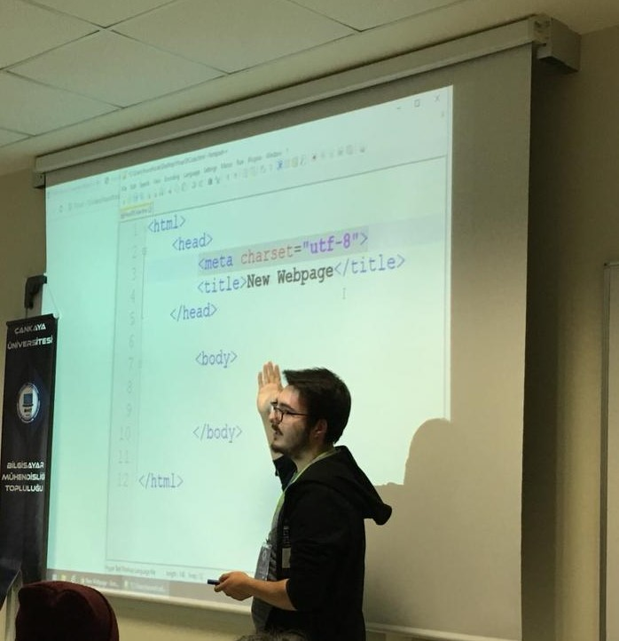



PROJECT MEMBERS
Oğuzhan TARHAN
Laçin BOZ
Cemre ÖZMEN
201711062
201811014
201711053

Slide 3
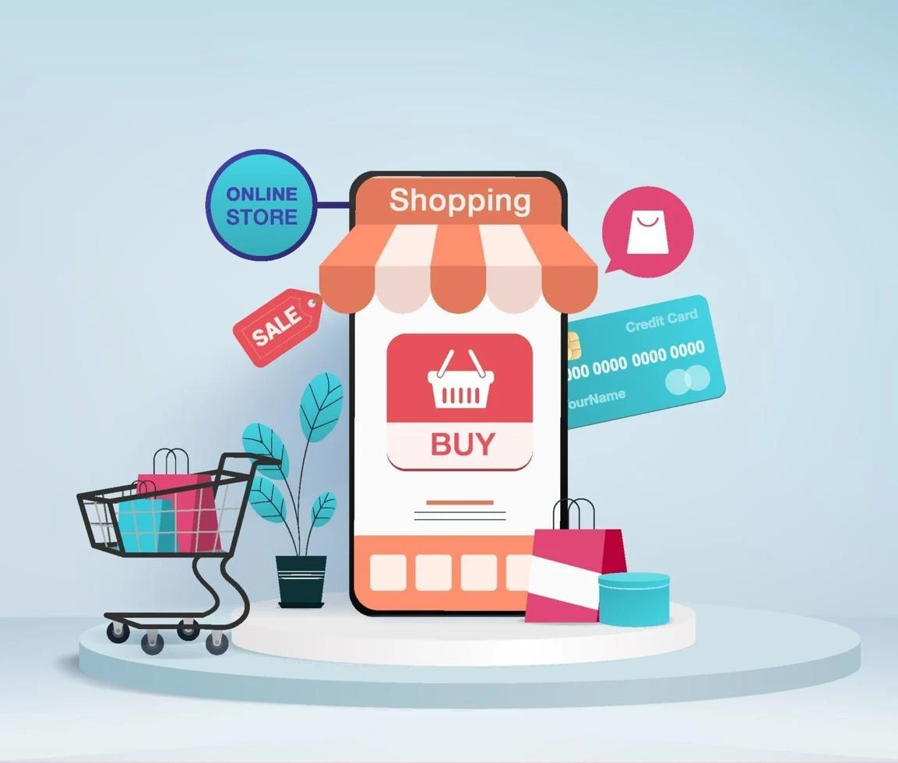
CONTENTS
Problem
What is Kloti?
Why Kloti is necessary?
Similar Projects
Solution
Technologies
What Happens After Kloti ?
User Interface Design-Customer
User Interface Design-Employee
Conclusion
References

Slide 4

PROBLEMS
Waste Of Time
Disease Risks
Slow Shipping
Not Being Able To Try The Product
Big Companies Earn More Than Small Companies
People Have To Leave The House To Shop
Less Product Visibility

Slide 5

WHAT IS KLOTI ?
Kloti is an online shopping application. This application aims to reduce shopping time and enable people to try on clothes without going out.

Slide 6
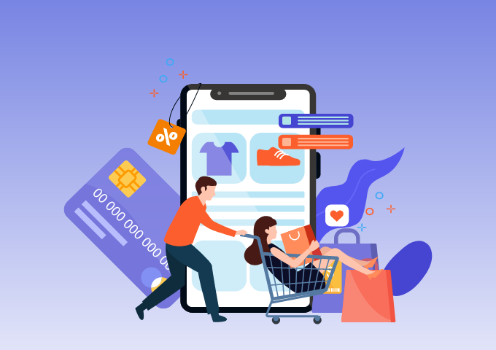
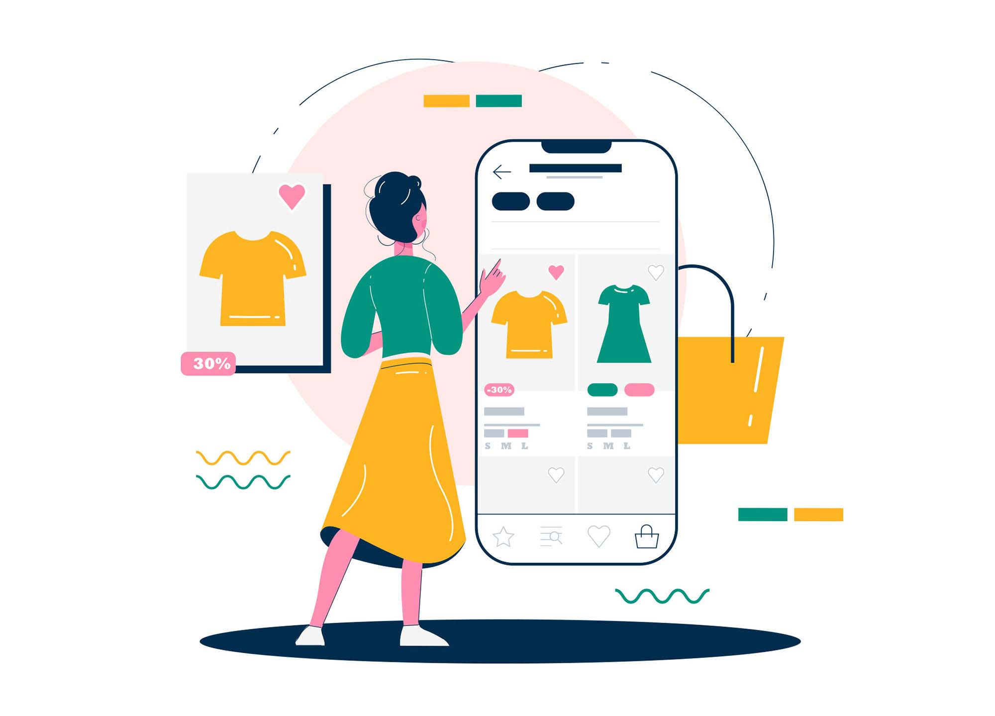
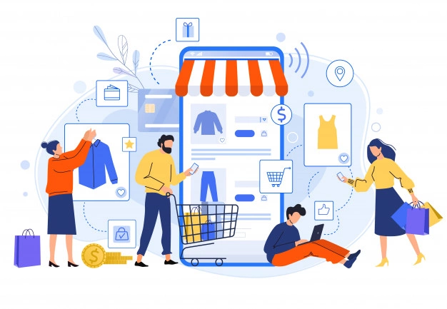

WHY KLOTI IS NECESSARY ?
Easy Accessibility
Away From Disease Risk
Saving On Time
Testability For Products

Slide 7

Customer can try the product using just the phone.
The order is delivered the same day.
Offers job opportunities to small companies.
All products are laid in front of the customer with a single click.
What Happens After Kloti ?

Slide 8

Solution
Developing this application:
It minimizes contact with people and thus reduces the risk of disease.
Allows you to try on the outfit using the camera.
It ensures that the order
arrives within the same day.
Allows small companies to earn money.
Finds your location via GPS and brings the product you want through the closest location to you.
Allows us to see the clothes you want through the product catalog.

Slide 9


Similar Projects
Project Name | Area | Access | Aim Of Project | Fast Shipping | AR
Trendyol | Online Shopping | Web/Mobile Based | A shopping platform that aims to make it accessible to everyone
Amazon | Online Shopping | Web/Mobile Based | To provide the shopping need around the world.
Getir | Online Shopping | Web/Mobile Based | The biggest goal of Getir is to fit the grocery shopping in 10 minutes, which would allow people to spend more time on their own even if they go to the market, pick it up and come home.
IKEA PLACE APP | Online Furniture Shopping | Mobile Based | IKEA Place lets you virtually 'place' furnishings in your space. | Not used in our country

Slide 10

IKEA PLACE APP

Slide 11

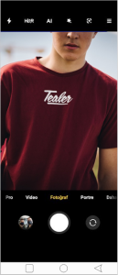
The Most Important Difference Of Kloti
Augmented reality (AR) involves overlaying visual, auditory, or other sensory information onto the world in order to enhance one's experience.
The AR technology we use , allows users to try the products they choose while shopping online.
Thus, the user's worry that the product does not fit the body is eliminated.

Slide 12


Potential Risks
Although it provides security well, cyber attacks can be made.
If the user does not update the application, the application may become slow and inefficient.

Slide 13






TECHNOLOGIES

Slide 14
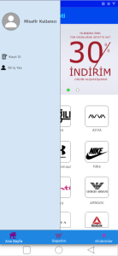
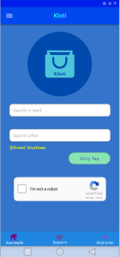
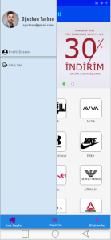
User Interface Design –All Users

Slide 15
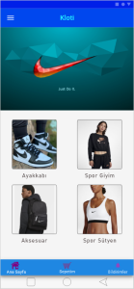
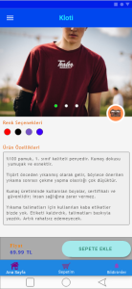
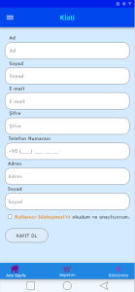
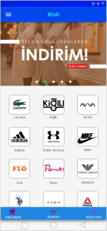
User Interface Design-Customer

Slide 16
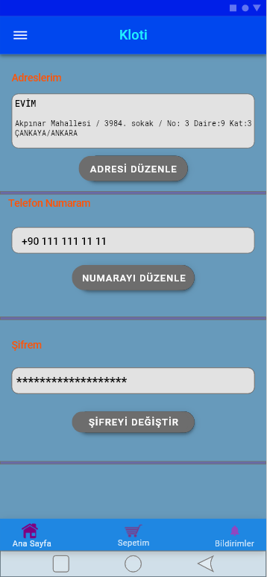
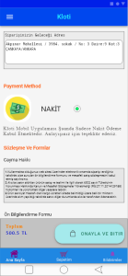
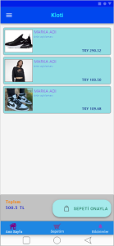
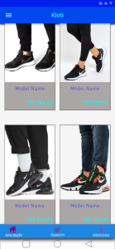

Slide 17
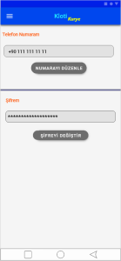
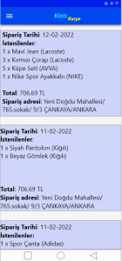
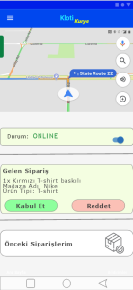
User Interface Design - Employee

Slide 18
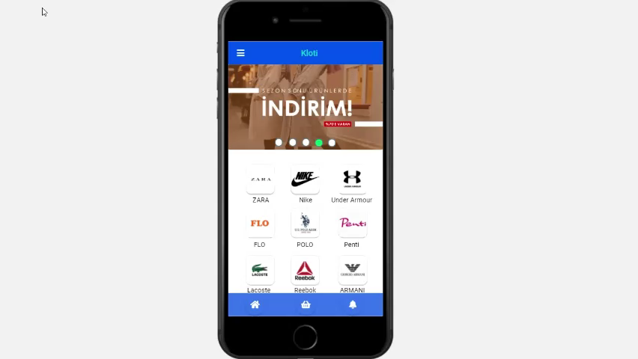

Slide 19
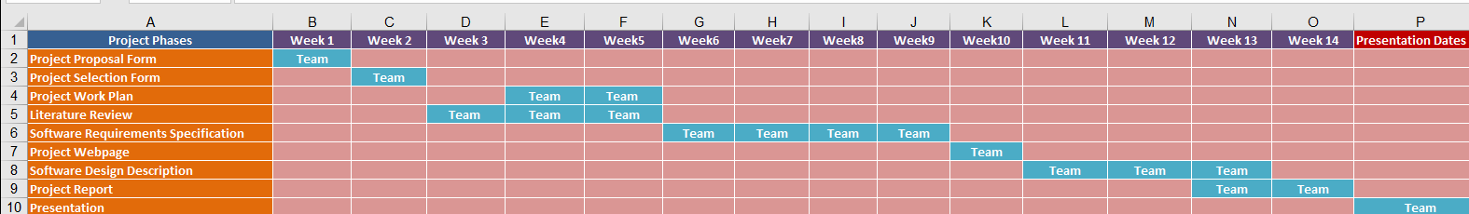
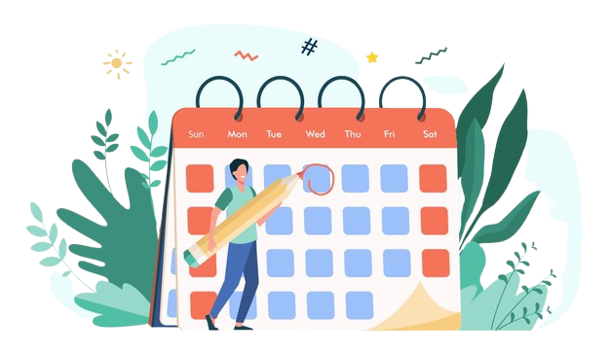
Work Plan

Slide 20
Conclusion
As a result, we will be able to shop more efficiently because this app uses the AR technology we developed by examining some shopping applications and because it provides fast delivery.
In addition, this application will appeal to many people because it can work on operating systems such as IOS and Android.

Slide 21

References
https://tr.wikipedia.org/wiki/Trendyol#:~:text=Trendyol%2C%202010%27da%20modayı%20herkes,bir%20alışveriş%20sitesi%20olarak%20kuruldu.&text=Moda%2C%20elektronik%2C%20ev%20ve%20mobilya,milyondan%20fazla%20paketi%20müşterilerine%20ulaştırıyor
https://www.adcn.nl/archives/ikea-place#:~:text=IKEA%20Place%20lets%20you%20confidently,the%20latest%20augmented%20reality%20technology
https://www.aboutamazon.co.uk/uk-investment/our-mission#:~:text=Our%20mission%20is%20to%20continually,creators%20to%20maximise%20their%20success.&text=We%20aim%20to%20be%20Earth%27s%20most%20customer%20centric%20company.,-Our%20mission%20is
https://www.pazarlamasyon.com/ilklerin-uygulamasi-getirinhikayesi#:~:text=Getir%27in%20en%20büyük%20amacı,Getir%27in%20önemli%20bir%20hizmet.
.

Slide 22
THANK YOU FOR LISTENING

